Slide 1

PROJECT pRESENTATION
LIBRARY MANAGEMENT SYSTEM
LIBRARY MANAGEMENT SYSTEM
Projected Guide: Submitted By:
Mrs.Prajkta Patil Mrs.Puja Ravindra Bansode
Mr.Bhanu Sir
CDAC Advanced Computing Training School, ATC NETCOM , Jaipur , Rajsthan

Slide 2
LIBRARY MANAGEMENT SYSTEM

Slide 3
INTRODUCTION
Library Management System is an application that is helpful for all student , teachers and any on
Library Management System is software that is designed to manage all the functions of a library.
Library Management System is software that is designed to manage all the functions of a library.
Library Management System is completely automates all your library’s activities.

Slide 4
LIBRARY MANAGEMENT SYSTEM USES
Library Management System is a software for monitoring and controlling the transaction in library.
Which is mainly focus on basic library operation.
The system requirement in library management system focuses on the possibility of search books by title, author or subject by member

Slide 5
LIBRARY MANAGEMENT SYSTEM USES CASE
Use cases of the Library Management System: Add/Remove/Edit book: To add, remove or modify a book or book item. Search catalog: To search books by title, author, subject or publication date. Register new account/cancel membership: To add a new member or cancel the membership of an existing member.

Slide 6
LIBRARY MANAGEMENT SYSTEM USES CASE
Use case diagrams referred as a Behavior model or diagram. It simply describes and displays the relation or interaction between the users or customers and providers of application service or the system. It describes different actions that a system performs in collaboration to achieve something with one or more users of the system. Use case diagram is used a lot nowadays to manage the system.

Slide 7
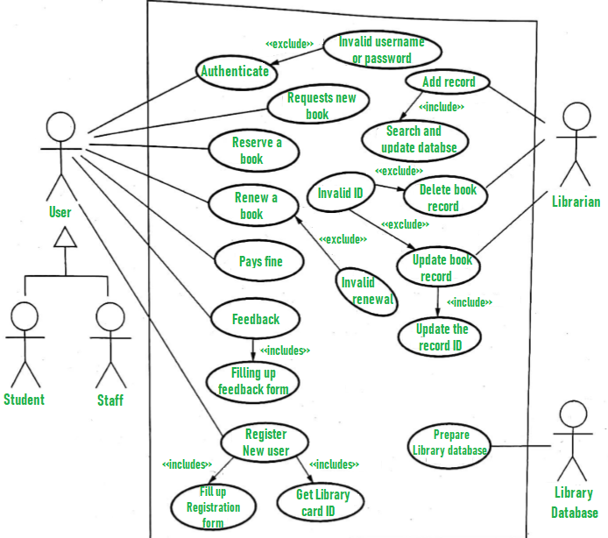
LIBRARY MANAGEMENT SYSTEM USES CASE

Slide 8
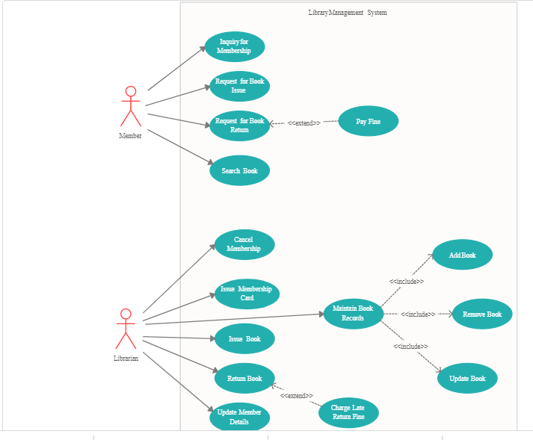
LIBRARY MANAGEMENT SYSTEM UML DIAGRAMS
UML Diagram’s is Unified Modelling Language

Slide 9
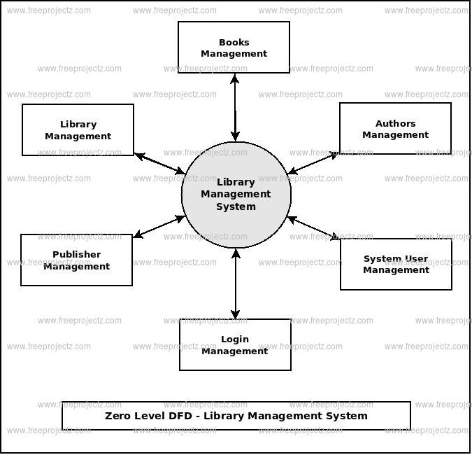
LIBRARY MANAGEMENT SYSTEM DFD
DFD means Data Flow Diagram

Slide 10
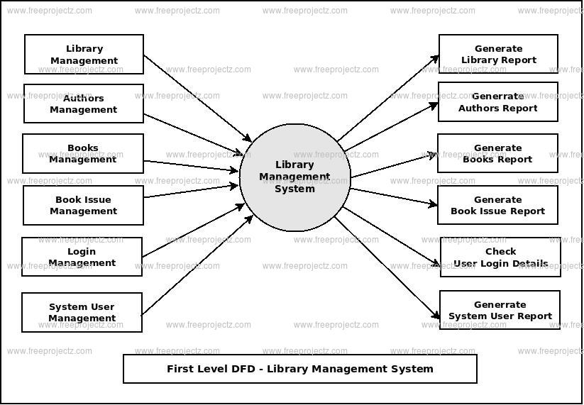
LIBRARY MANAGEMENT SYSTEM DFD
DFD means Data Flow Diagram

Slide 11
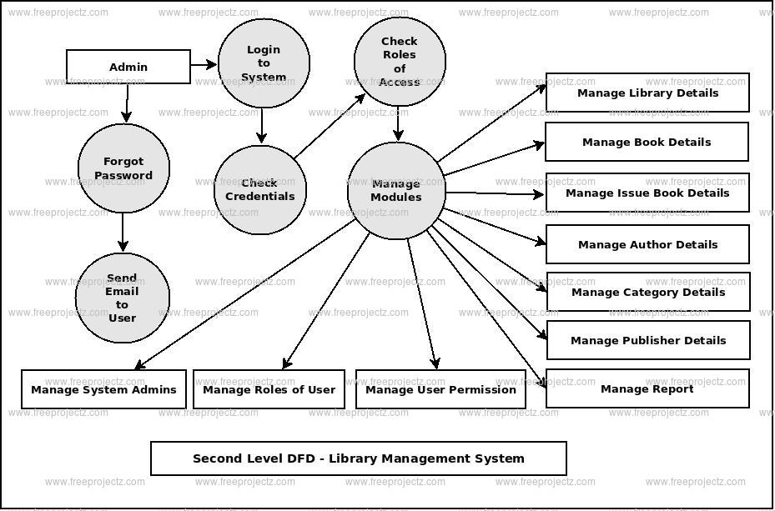
LIBRARY MANAGEMENT SYSTEM DFD
DFD means Data Flow Diagram

Slide 12
LIBRARY MANAGEMENT SYSTEM DFD
DFD means Data Flow Diagram

Slide 13
LIBRARY MANAGEMENT SYSTEM DFD
DFD means Data Flow Diagram

Slide 14
Team Memebers and Rsponsibility Puja Ravindra Bansode Responsibility is working on all projects requirements , like design, source code, project report, ppt etc.

Slide 15
FUTURE SCOPE
To assist the staff in capturing the effort spent on their respective working areas. To utilize resources in an efficient manner by increasing their productivity through automation. The system generates types of information that can be used for various purposes.
Library Management System are to reduce overheads and increase productivity. The librarians can maintain all library functions easily. In short, this system supports keeping the records of all transactions of the books available in the library.

Slide 16
THANK YOU

